Slide 1

Urban Happiness
Ayushi Sharma

Slide 2
Introduction
Relocating to another place is a very difficult task.
What if a family man wants to move and is unaware of the environment around his selected neighborhood? This is where the project Urban Happiness comes in.
Urban Happiness presents a map to the user with the crime ranges of the locality and the clustered neighborhood based on the venues. It also outputs the closest neighborhood from the venue given by the user.
The map marks two neighborhoods that are close to the venue given by the user.
The project clusters the neighborhoods based on all the venues and the crime rate in that neighborhood into three clusters and shows it to the user via a map.

Slide 3
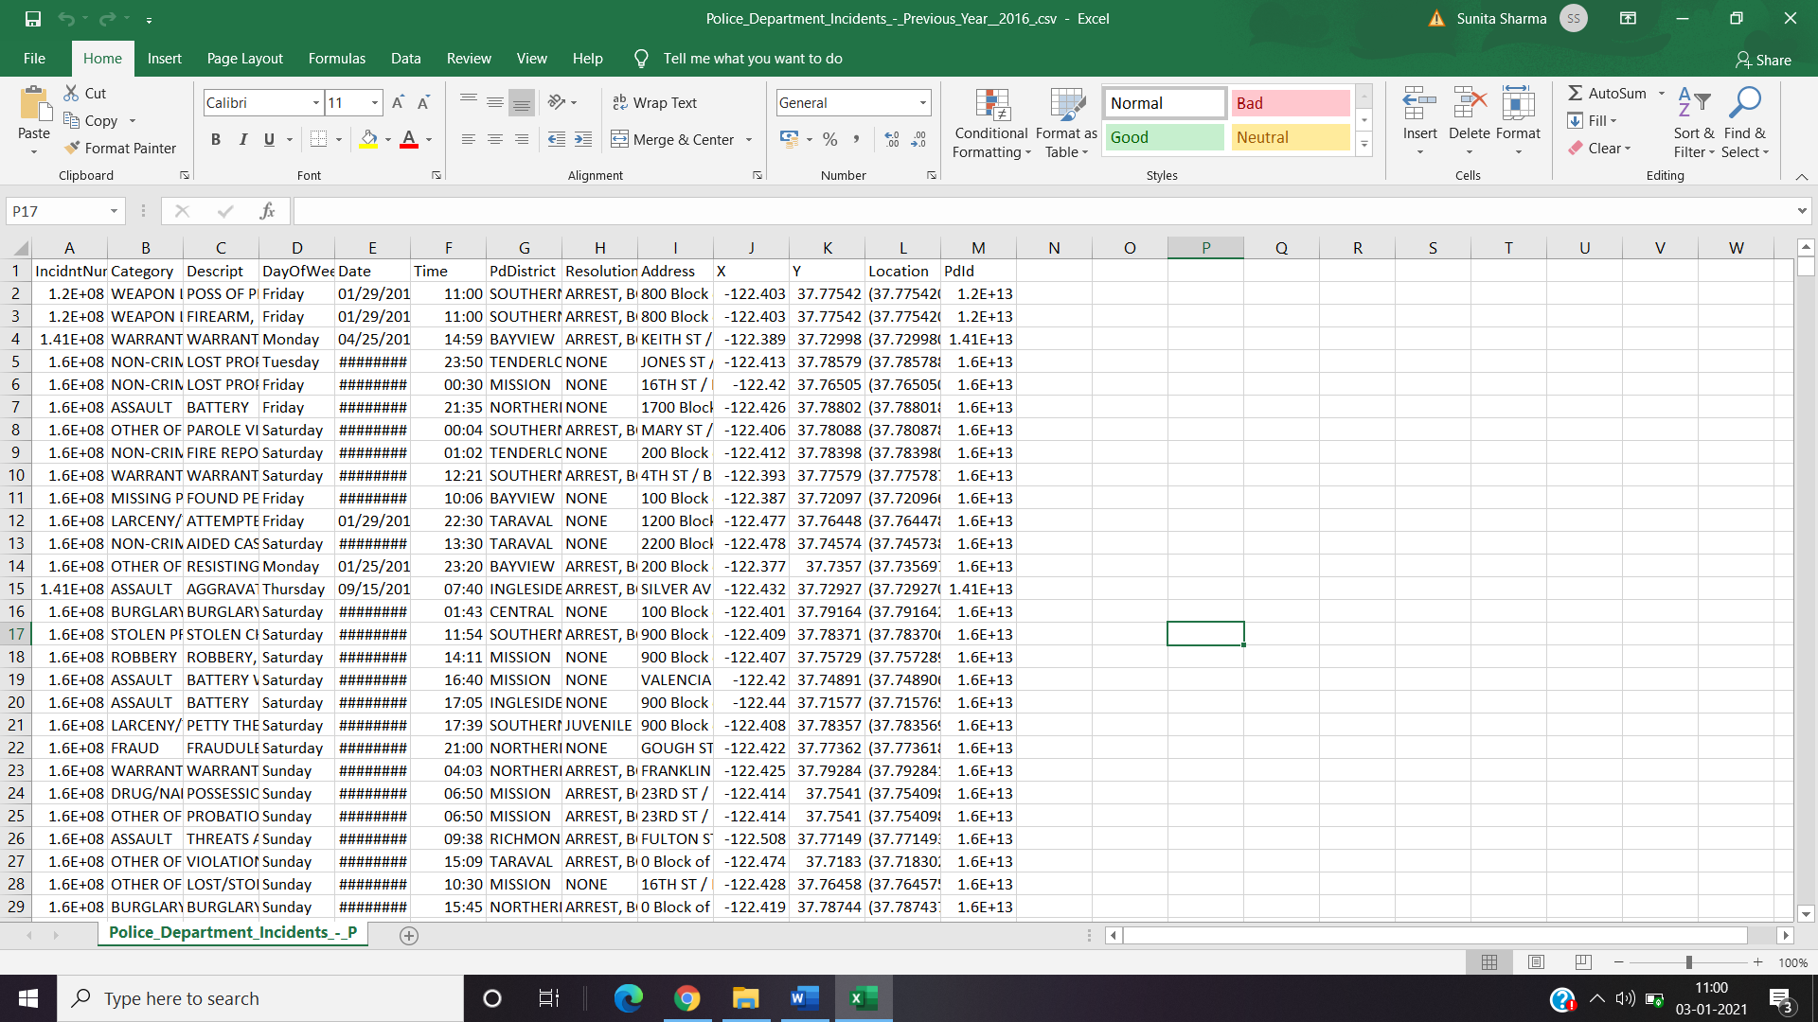
Data
Crime Rate csv file

Slide 4
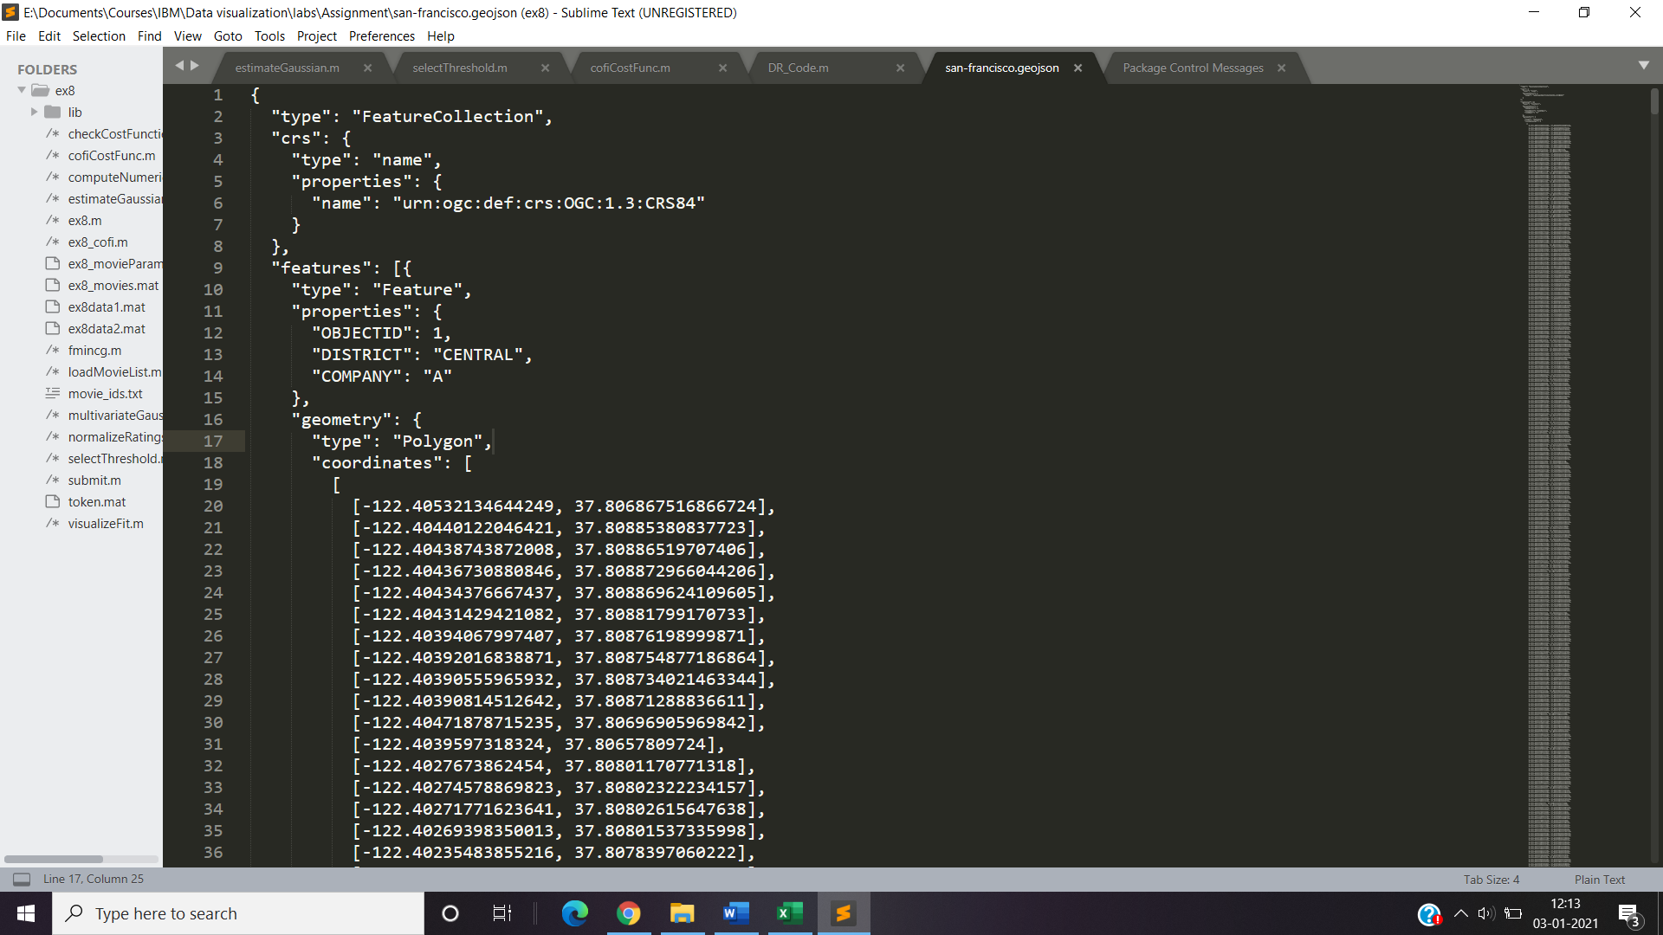
San Francisco GeoJson file.

Slide 5
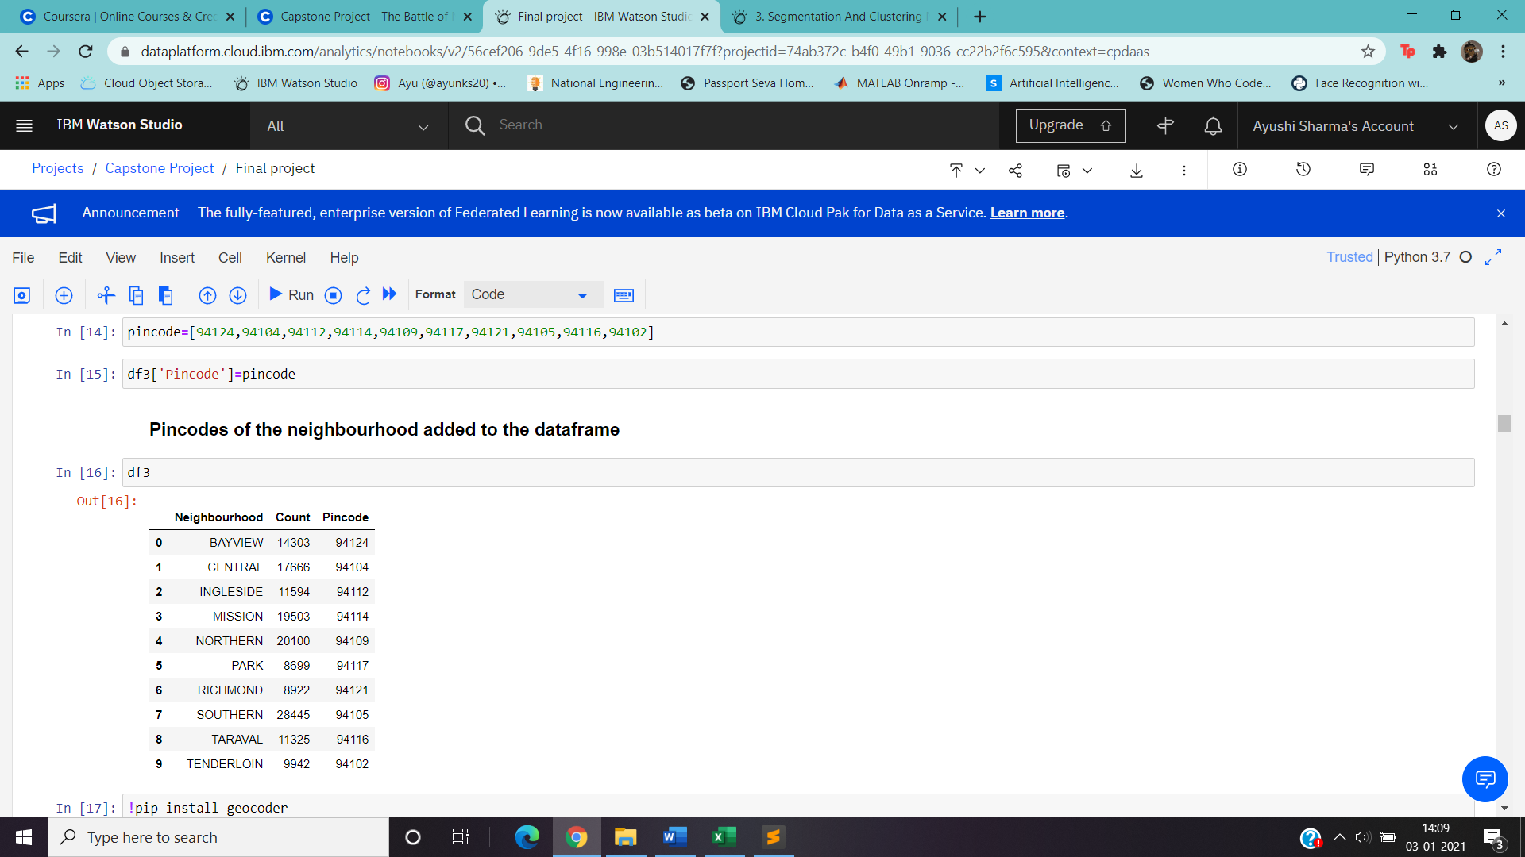
Postal Codes

Slide 6
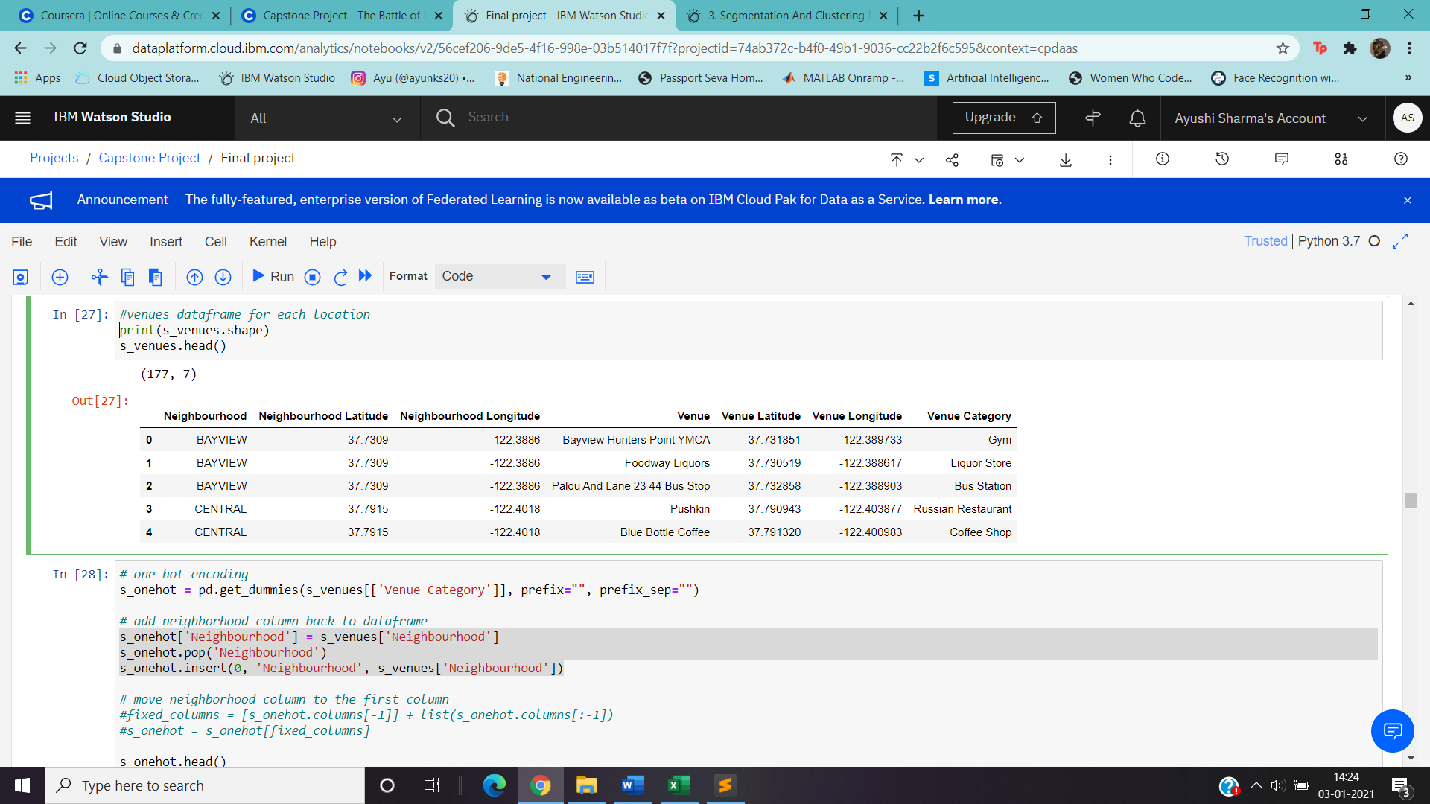
FourSquare API
The foursquare API is used to fetch the list of venues that are close to the given latitude and the longitude. The API uses the client ID and the Client Secret to fetch the details.
The response can then be converted to a pandas data frame and then be used for further operations.

Slide 7
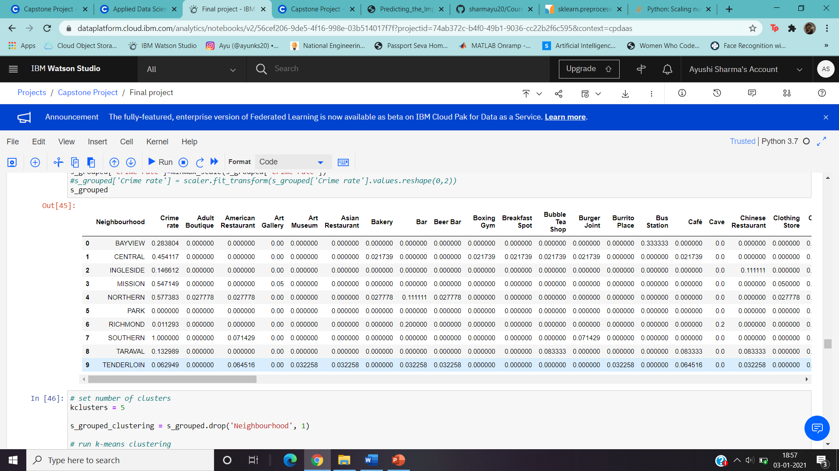
Methodology
Data Pre-processing
The data from the csv file is processed so that the data is stored in the data frame with neighborhood, count as the columns.
One Hot Encoding is done on the foursquare response.
The data is then response is added to get the below data frame.
Each column is pre-processed and scaled down to a value between 0 and 1.

Slide 8
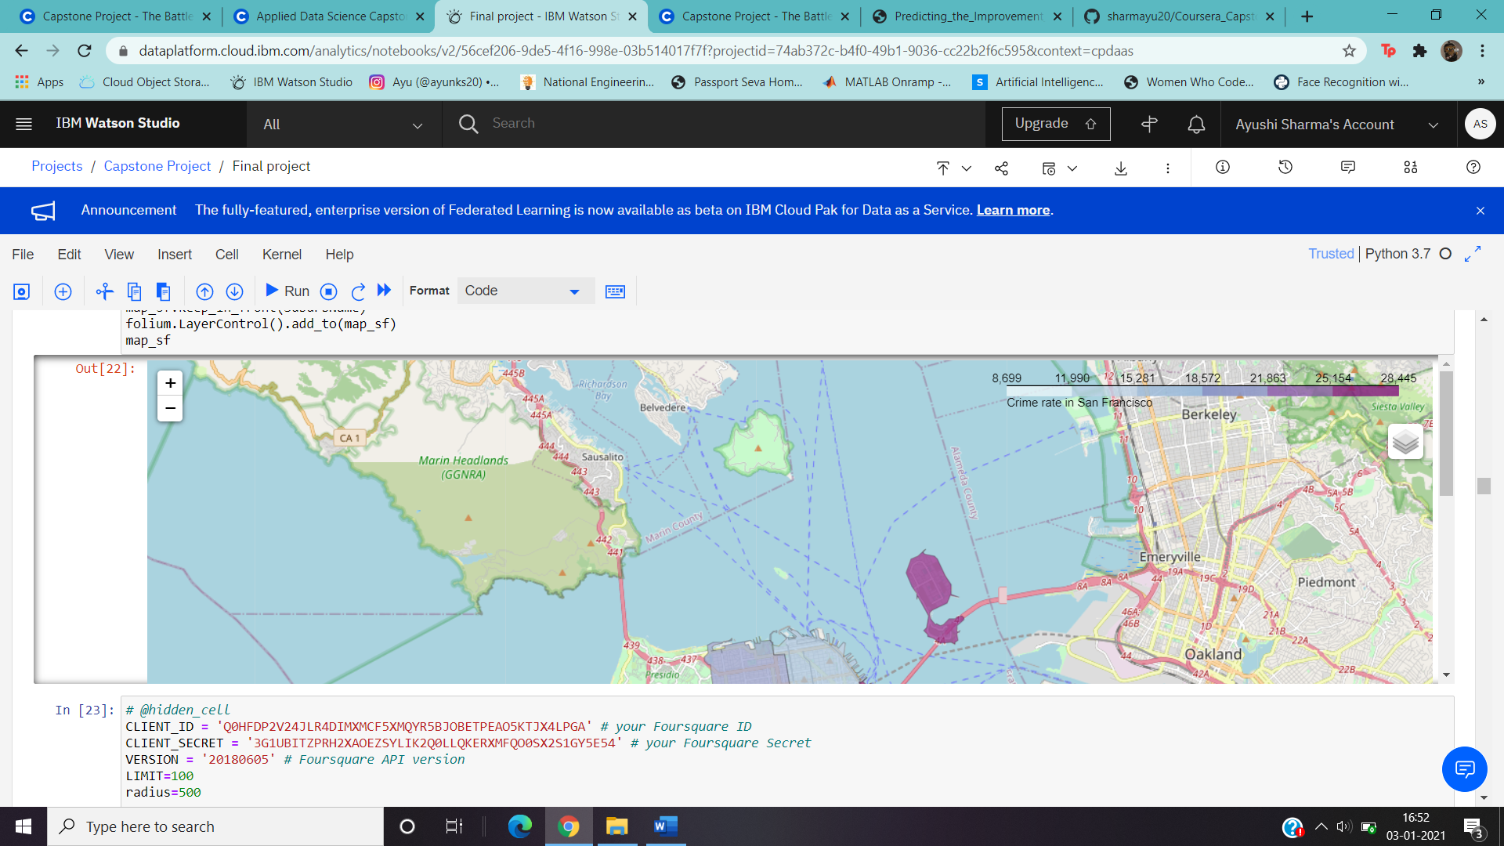
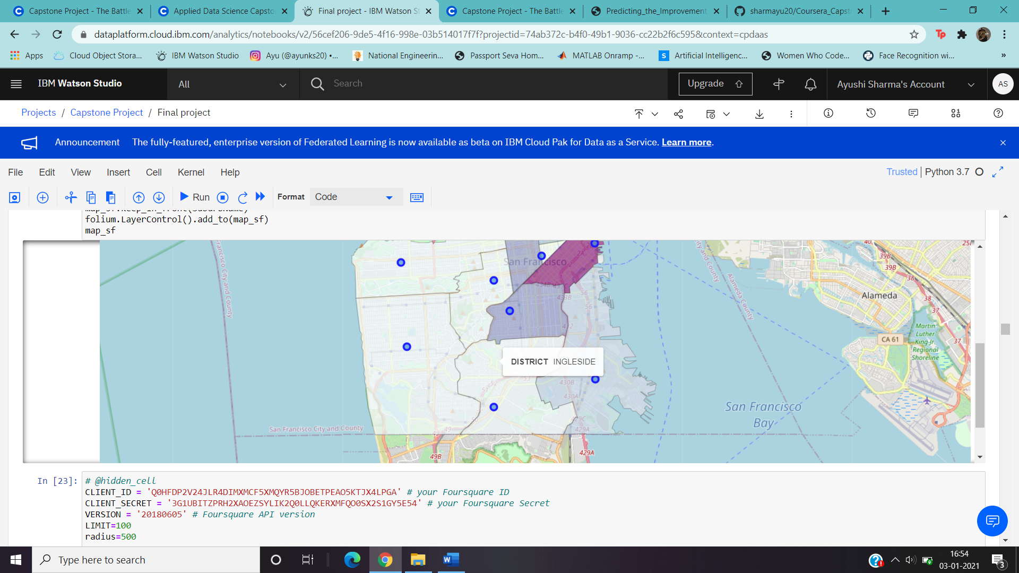
Data Visualization
1. Chloropleth map is shown to view crime rate

Slide 9
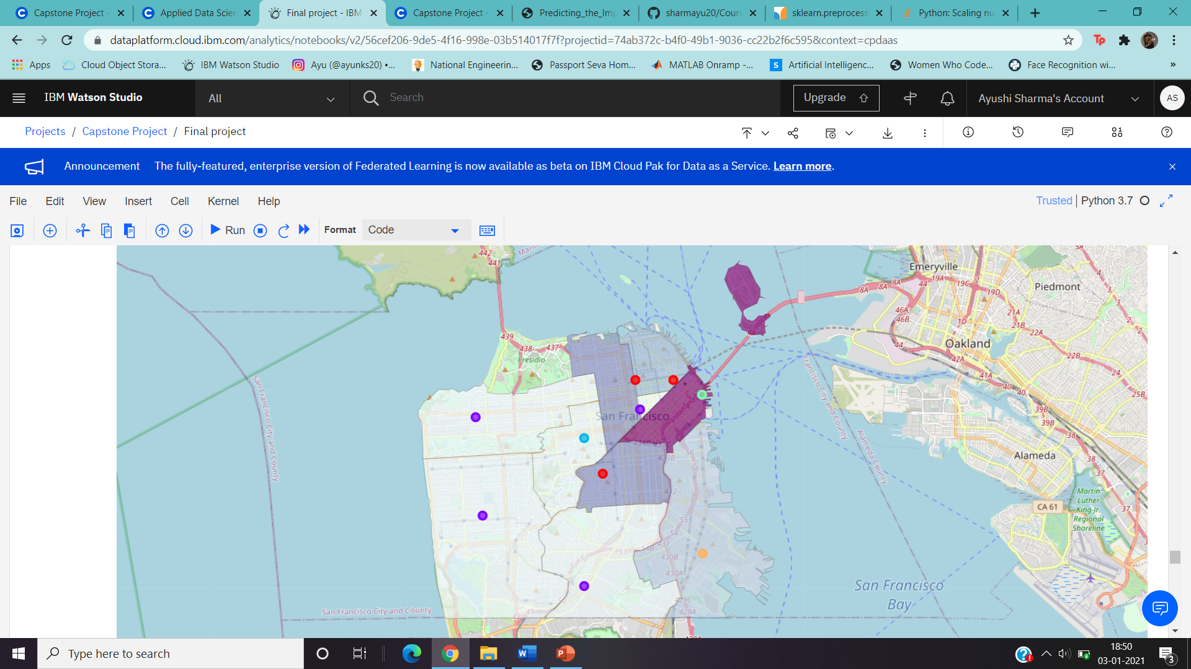
2. Coloured markers for different clusters.

Slide 10
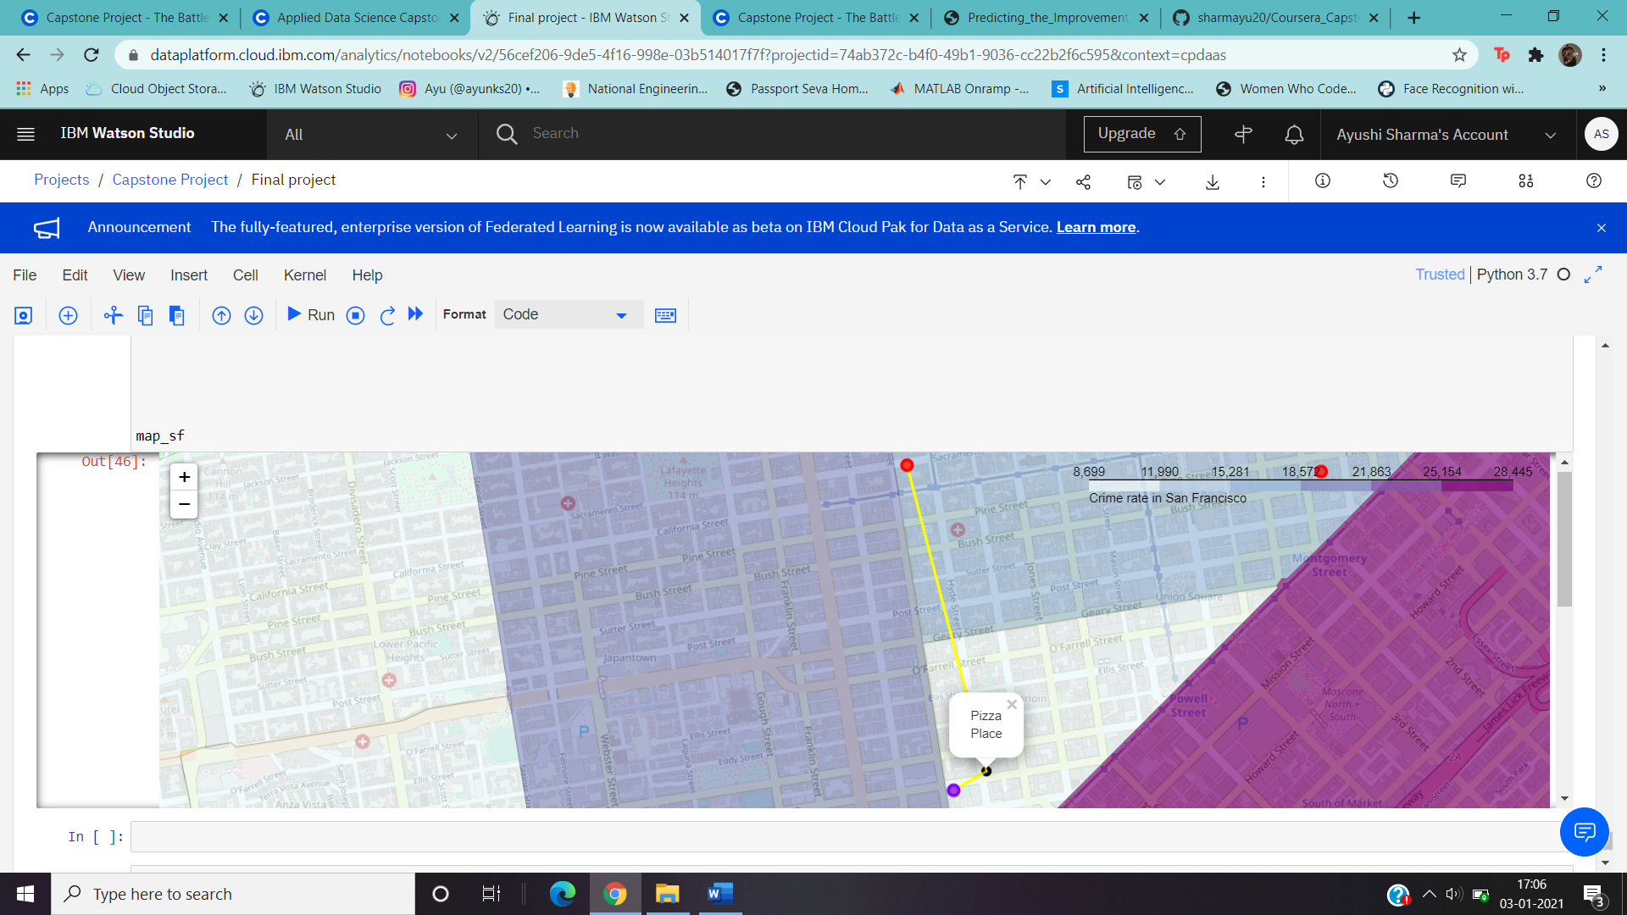
Marking the closest neighbourhood to the given venue.
Two nearest neighbourhood marked in the map are shown using the yellow line.

Slide 11
Machine Learning
K-Means clustering is used to cluster the neighborhoods. Since the label in which the neighborhoods are not known classification algorithm cannot be used.
The output gives 5 clusters which are marked on the map.

Slide 12
Results
The user is shown the common venues of a location
The user is also shown the closest neighbourhood to the venue they selected.
The future scope of this project can also be to design a front end and show the users the most favourable neighbourhoods that the user can live in.

Slide 13
Thank You!

